Slide 1

Medical Imaging
RANZCR CLIP
Paolo Sofia, Matteo Carollo

Slide 2
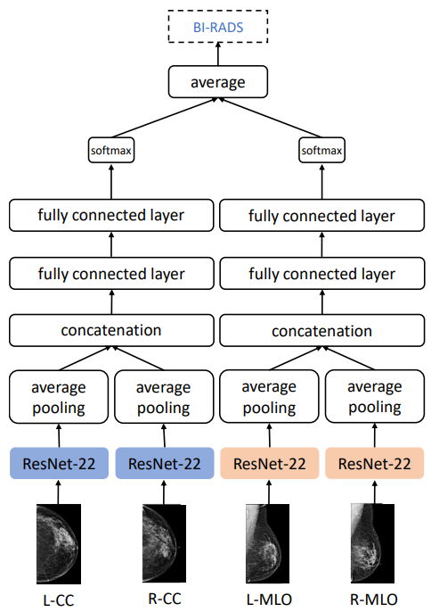
Similar approaches - classification
We started our work taking into consideration this initial approach. Unfortunately, due to the limited time available, we simplified this approach, using a single model and attached a different head for each label group.

Slide 3
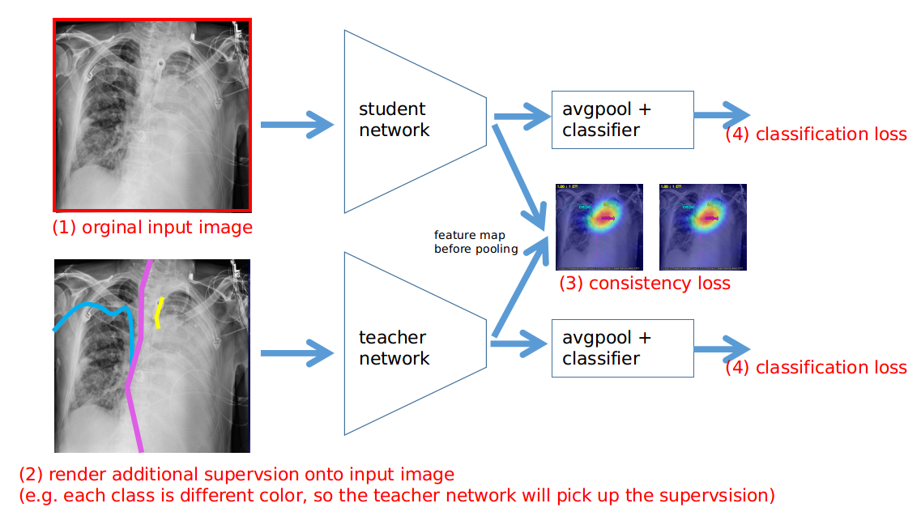
Similar approaches: distillation
We took inspiration also from other proposed method on kaggle, such as this one. We simplified our model by training a simple siamese net and then we fine tuned the model.

Slide 4
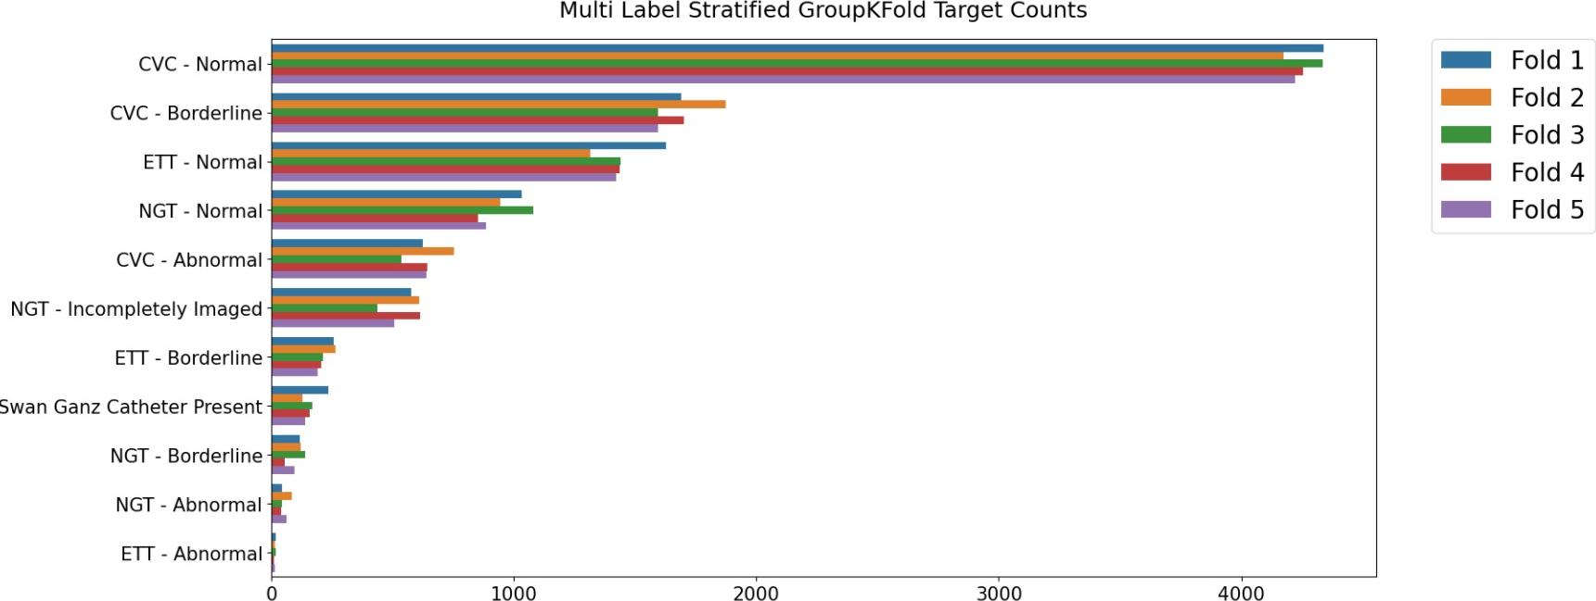
Our work - Dataset
Dataset issue:
Unbalanced labels
Data leakage
Solution:
Compute weights for each label
Split train and validation set by patient maintaining the same label distribution

Slide 5
Our work - Models, Losses, Optimizers comparison
Our initial approach was to compare different CNN, loss functions and optimizers to find the best combination of them
CNN
Resnet18
Resnet101
Resnest50
Inception V3
Densenet169
EfficientNetB2
Xception
LOSS FUNCTIONS
BCE
Weighted BCE
Weighted BCE + L1
Weighted BCE + L2
Weighted BCE + L1 L2
ELR
Focal Loss
OPTIMIZERS
Adam
Adam w. Decaying Momentum
SGD w. Decaying Momentum
Yogi
Adabound
Adabelief

Slide 6
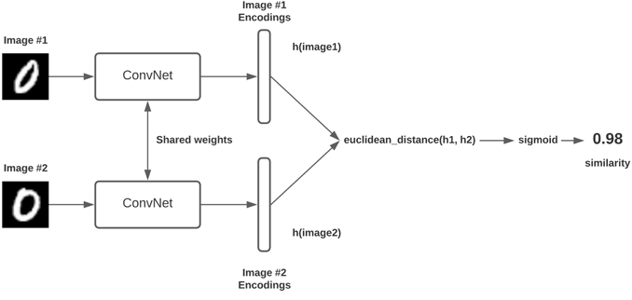
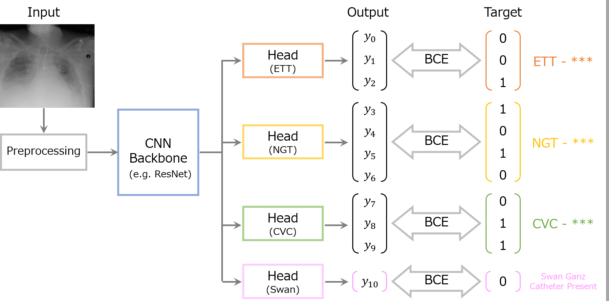
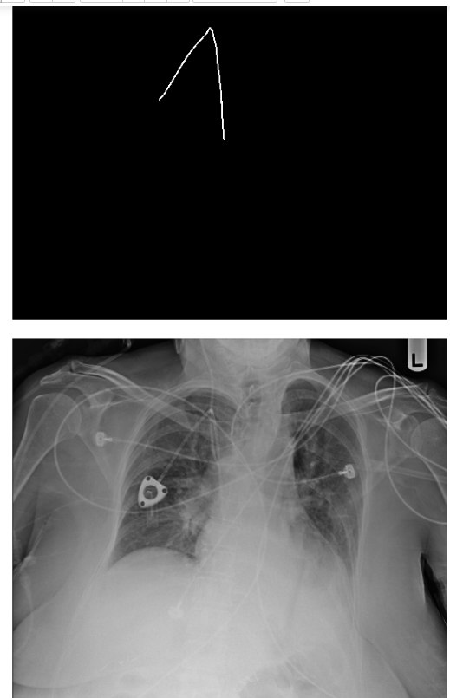
Our work - Other approaches
Siamese Net
2 stages training
Train siamese net
Transfer learning siamese net weights to original net
Multi headead net
Different Head for each group of labels

Slide 7
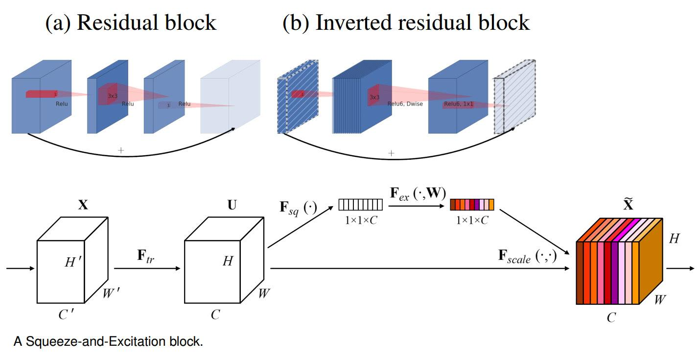
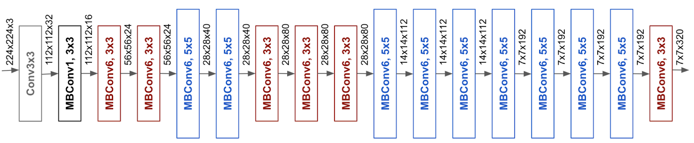
Architecture - EfficientNet B2
It has the best tradeoff between speed and performance
How it works:
Inverted residual block
Squeeze and excitation block

Slide 8
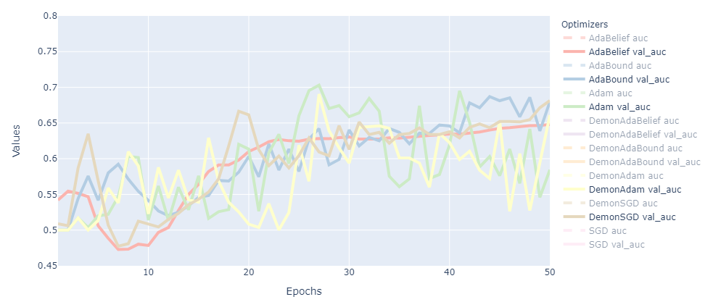
Results - Optimizer
Adam is less stable, but it is faster to converge and achieves best results, so we chose it as optimizer. Then we used Adabelief for a second stage training as it behaves better in proximity of the minima

Slide 9
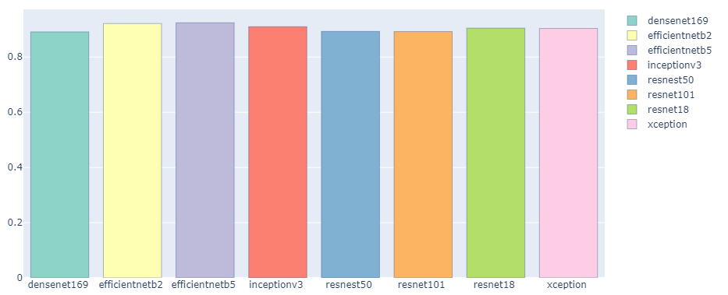
Results - Models
EfficientNetB5 has slightly better performance than EfficientNetB2, but it is larger and and slower, so we chose EfficientNetB2 also to avoid overfitting.

Slide 10
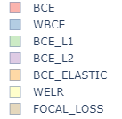
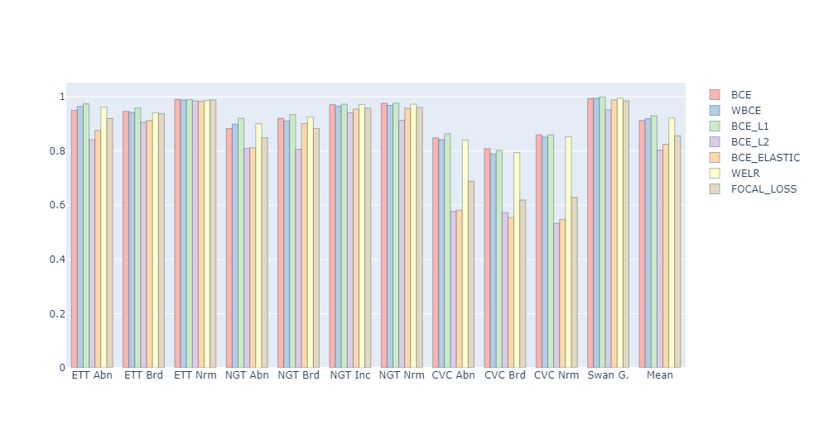
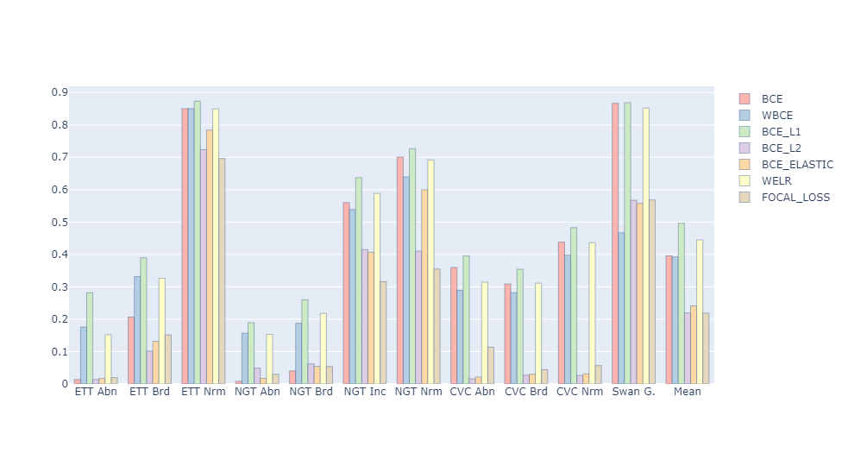
Results - EfficientNet B2
AUC
Training 0.9575
Validation 0.93
Area MCC
Training 0.5585
Validation 0.4962

Slide 11
Conclusion
The model used is very simple, but performance are good, even though, with better design of either siamese net or multi headed net, higher scores could be achieved.
Compared to other models on kaggle, our performance may appear inferior, but on kaggle they focus on winning competition, ignoring three important aspects:
Data leakage
Loss functions
Noise as data augmentation technique

Slide 12
Future work
Instance segmentation
Use the dataset annotations to use instance segmentation and then classify the segmented images
Distillation methods
Use teacher-student model using also annotation data
Multi headed net
Improve the design of the head, or use a different model for each group of data and then concatenate the results. In this case the models does not share the weights

Slide 13
Thanks for your attention

